Slide 1
Happy Birthday Del
85 Wonderful Years

Slide 2
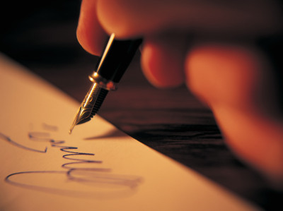
You Are About To See… The Story Of Del
Subtitled: Zero to 85
The names have been changed to protect the innocent

Slide 3
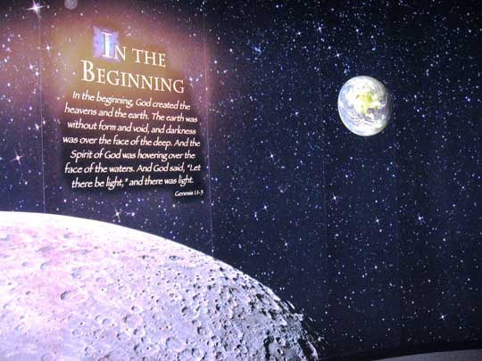
In The Beginning…
Most people think it was Adam and Eve It wasn’t… It was Del and Eve
85 Years Ago It Was MCMXXIV

Slide 4
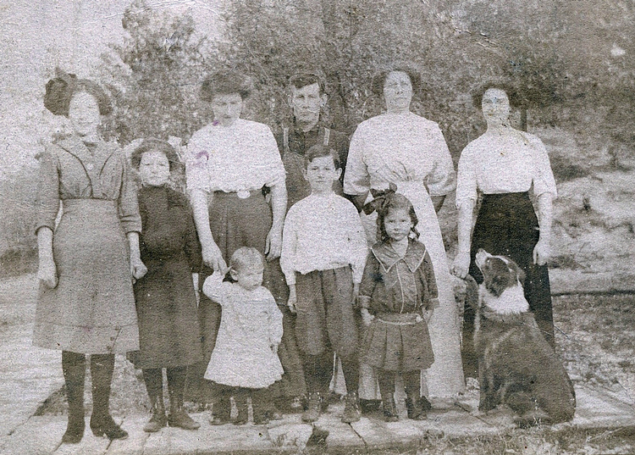
Del’s Family 1913
I’m Del’s Grandpa
How about another dog!
February 13, 1913 - The 16th Amendment to the United States Constitution is ratified, authorizing the Federal government to impose and collect income taxes.

Slide 5
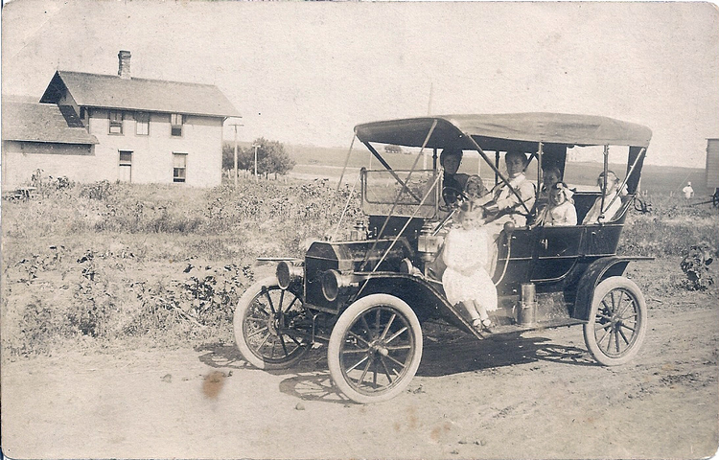
Del’s Mom Liked Cars Before He Was Born… It’s In The Genes
Slow this contraption down!
Did you know?
The word “DEL”
In Old English
means automobile!
July 10, 1913 – Death Valley, California hits 134 °F (~56.7 °C) which is the highest temperature recorded in the United States.

Slide 6
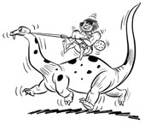
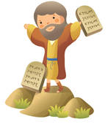
Del Was 18…. Months That Is
2010 - 85 = 1925
His favorite pet
Del’s playmate
I’m so cute!
1925 - Scopes Trial: In Dayton, Tennessee, high school biology teacher John T. Scopes is found guilty of teaching evolution in class and fined $100

Slide 7
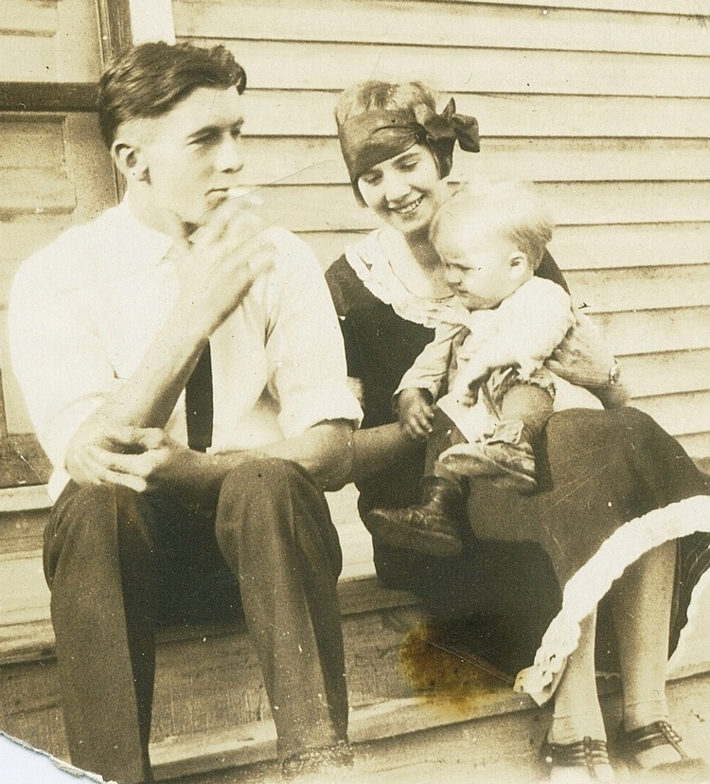
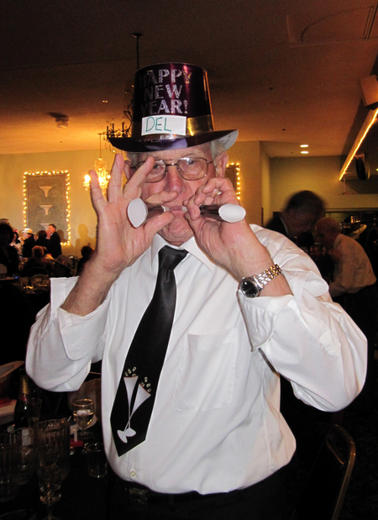
He Must Have Been A Beautiful Baby…
Toot Toot
Because boy look at him now!
1927 - Bell Telephone Co. transmits an image of Herbert Hoover (then the Secretary of Commerce), which becomes the first successful long distance demonstration of television

Slide 8
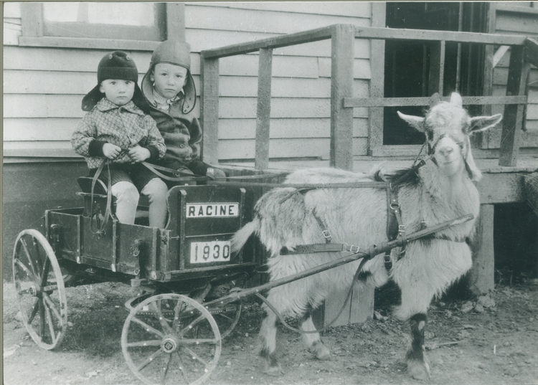
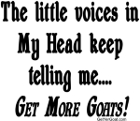
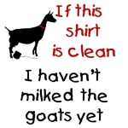
Del And Little Brother (Del Is Not The One Pulling The Wagon)
Go goat!
YOU will be an old goat some day!
Hey, it’s a start! One GHP (Goat Horse Power)

Slide 9
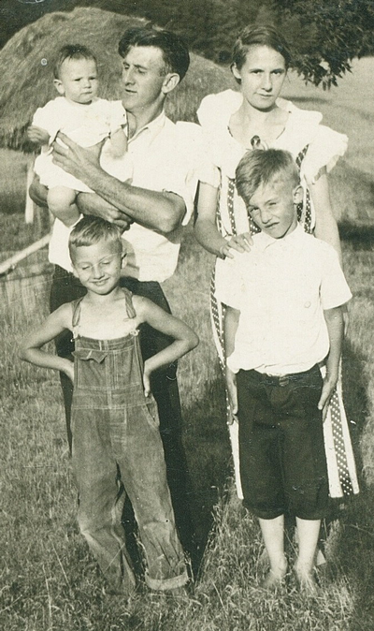
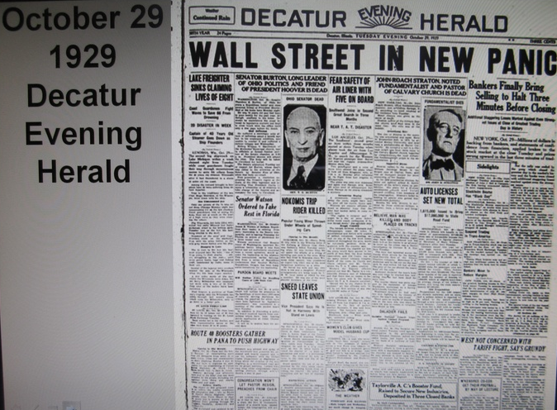
Life Gets Tougher In 1929. . .
Del was four when it began and was nine in this photo
March 8, 1930 - "President Hoover predicted today that the worst effect of the crash upon unemployment will have been passed during the next sixty days." - Washington Dispatch.

Slide 10
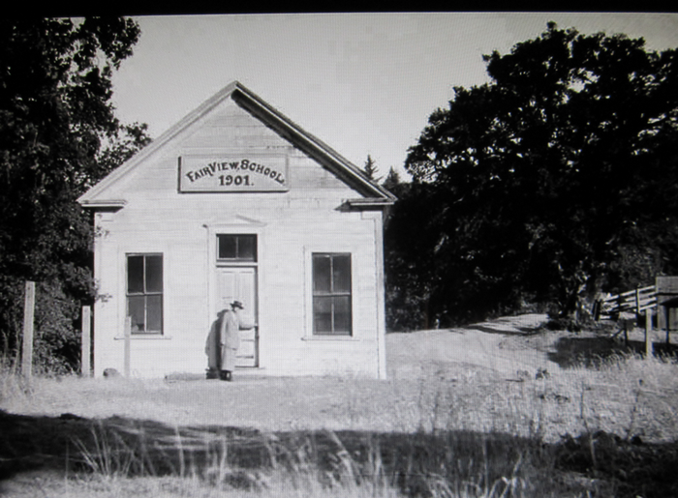
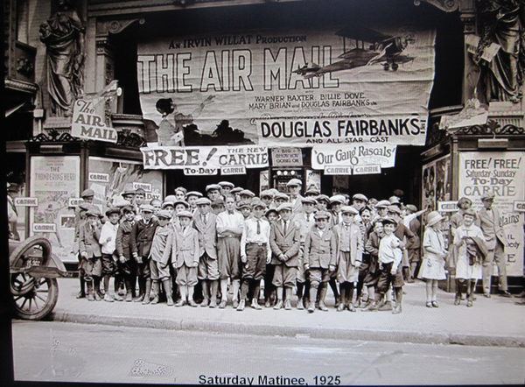
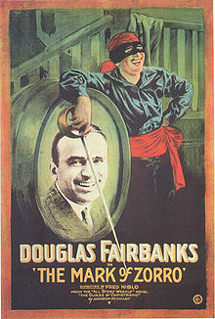
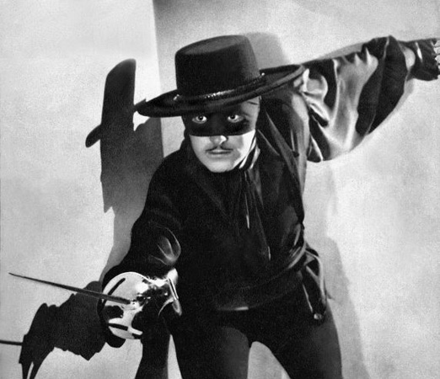
Del Liked School And The Movies
Move over Douglas… A real star is here now

Slide 11
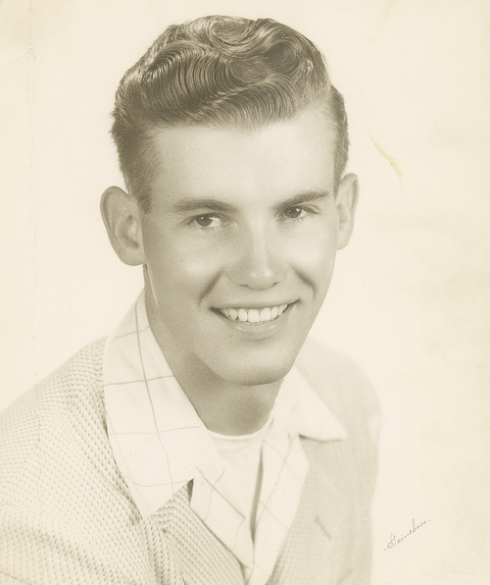
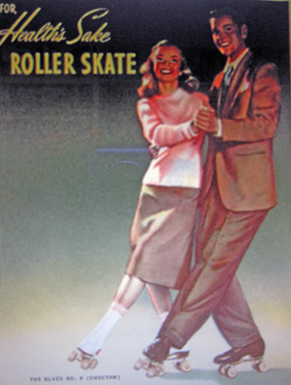
Del Makes It To High School In 1938
You mean I can hold a girl if I learn to roller skate?
All Skate!

Slide 12
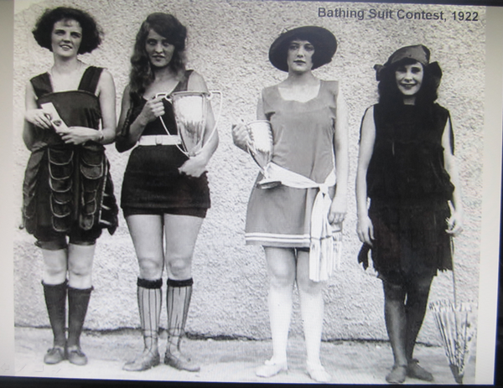
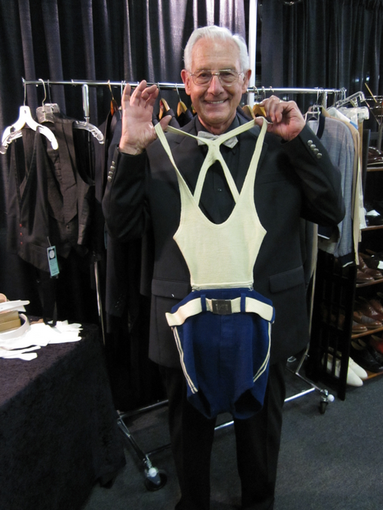
Del Discovers Girls
Naughty boy!
I’m so cheap I still wear mine

Slide 13
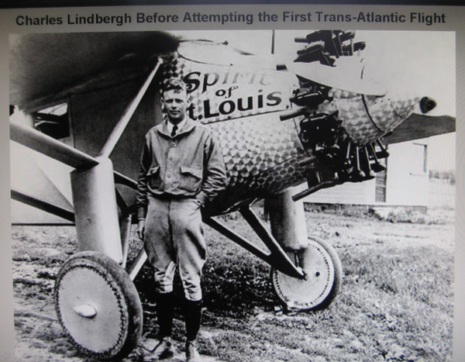
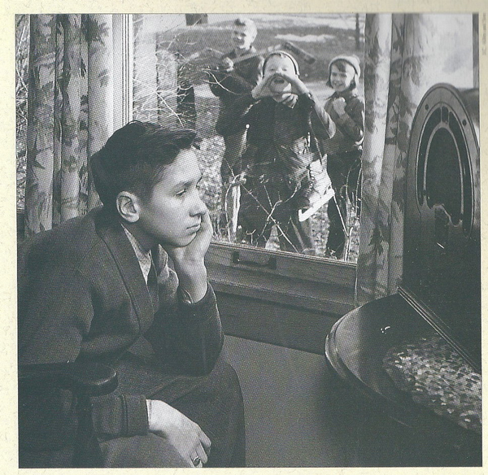
Cowboys & Flying Adventures Courtesy Of The Radio
Up Up and away! One day I will fly!
“My father hated radio and could not wait for television to be invented so he could hate that too.” – Ed Sullivan
1938 - Walt Disney's Snow White and the Seven Dwarfs, the first cell-animated feature in motion picture history, is released in the United States.

Slide 14
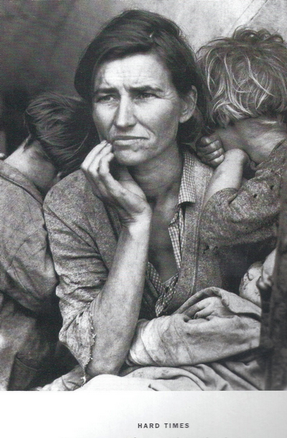
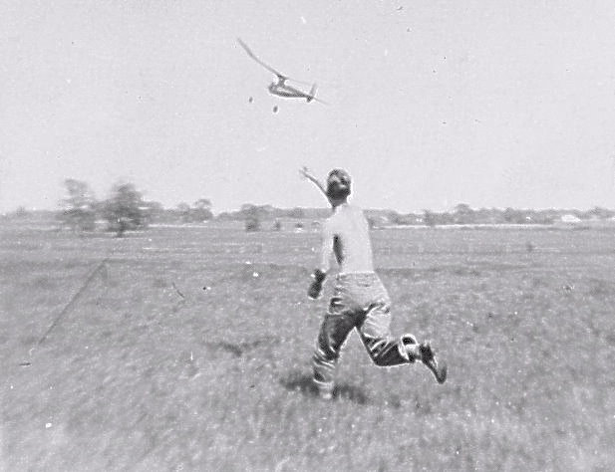
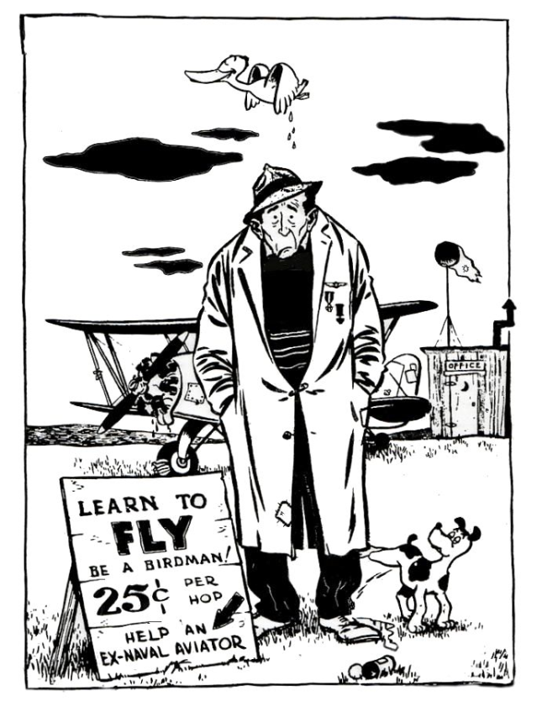
The Depression Was Difficult But Del Did What Del Does… He Moved On
Del kept them flying
Hard times for all

Slide 15
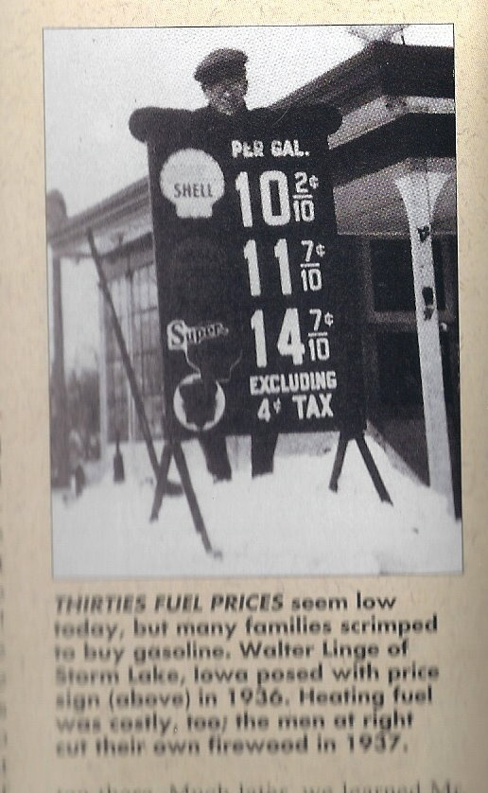
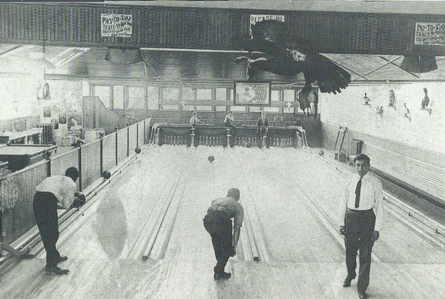
1938 - Prices Where High; Del Got A Job
Ouch!
Del was paid five cents a game…. To retrieve and set up the pins
January 8 1940 – WWII – Food rationing begins in Great Britain. The war clouds are gathering

Slide 16
1941 - The World Changed For Eveyone!

Slide 17
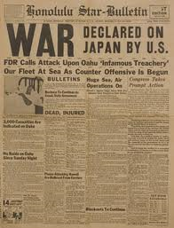
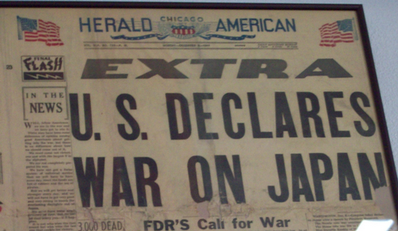
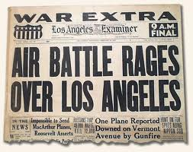
1941 - Del Is Seventeen When. . .
December 7, (December 8, Japan standard time) – The Japanese Navy
launches a surprise attack on the United States fleet at Pearl Harbor,
thus drawing the United States into World War II.

Slide 18
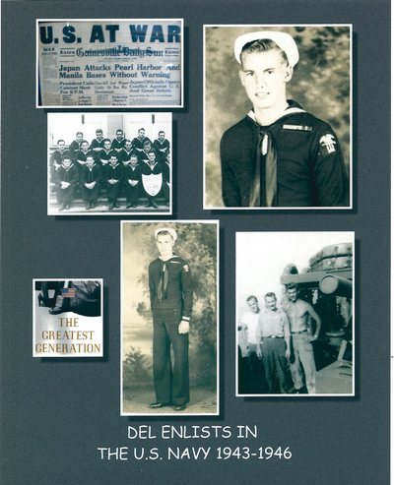
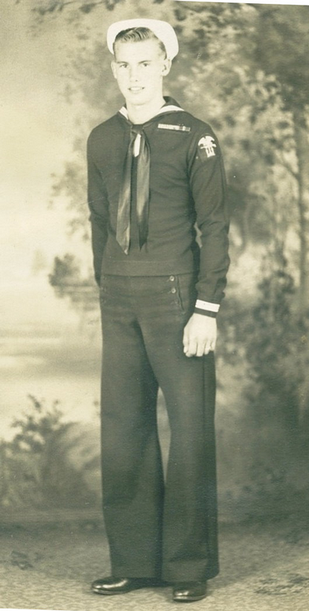
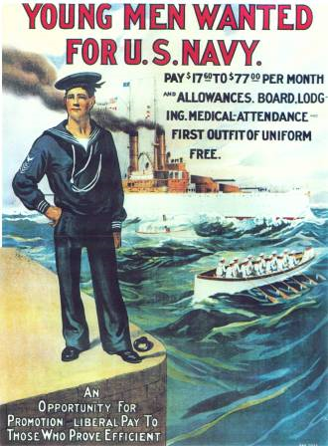
1943 - The Enemy And The Ladies Didn’t Have A Chance!
Seaman Del Kuhn

Slide 19
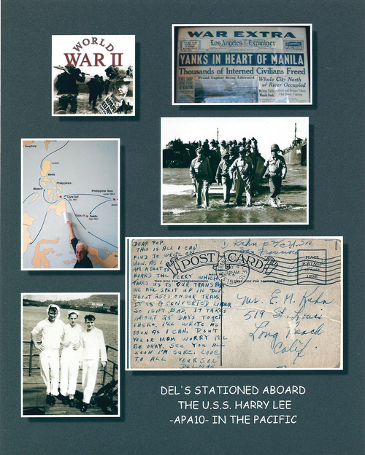
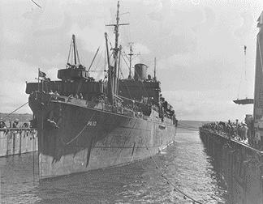
Del Served In The Pacific Theater 1943-1946

Slide 20
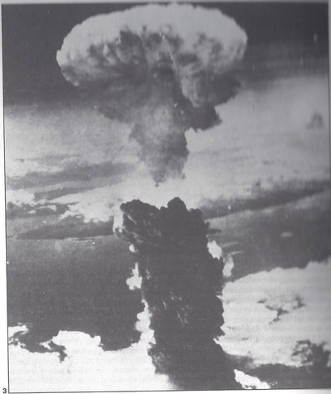
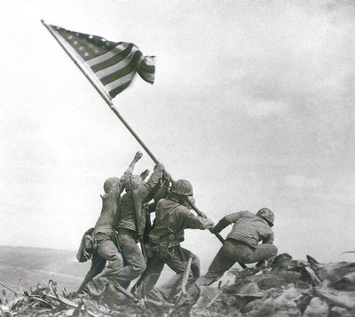
The War Is Almost Over
Iwo Jima
On August 6, 1945 the Americans dropped an atomic bomb on Hiroshima.
It’s over now!
Del is coming home!

Slide 21
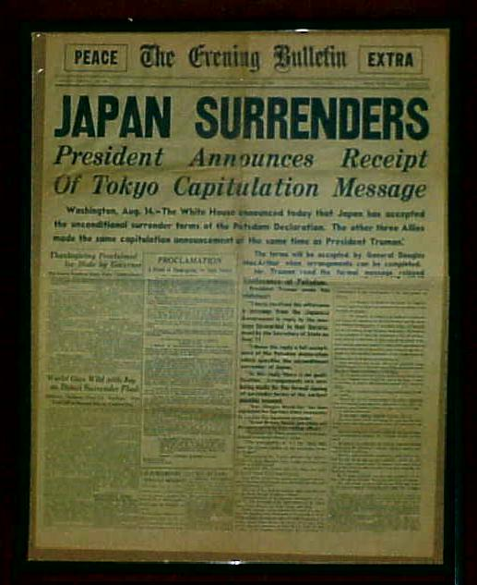
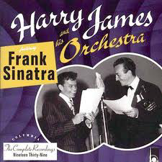
The War Is Over In The Pacific Time To Play

Slide 22
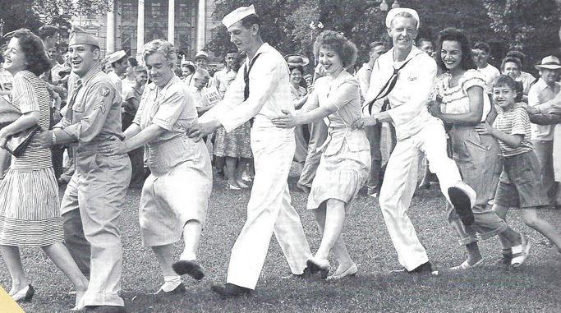
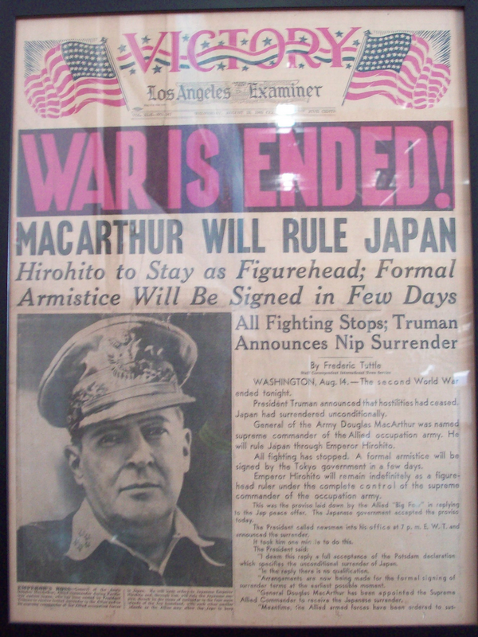
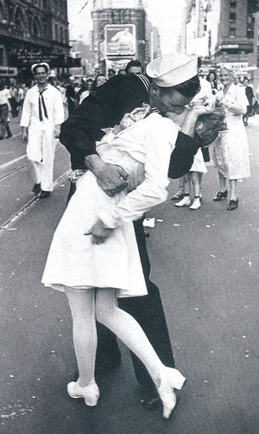
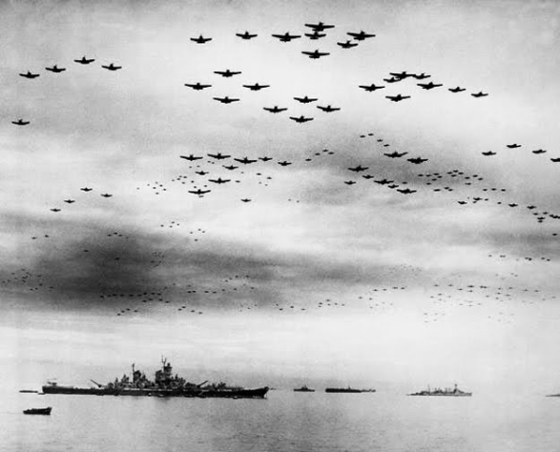
It’s Over Over There!
Yes, It was really me!

Slide 23
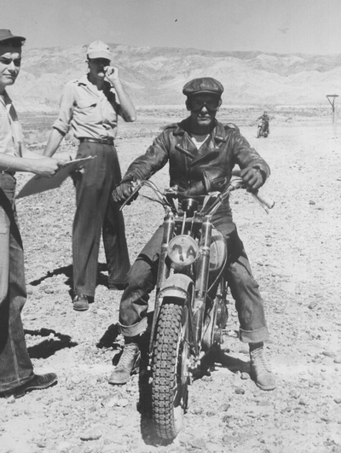
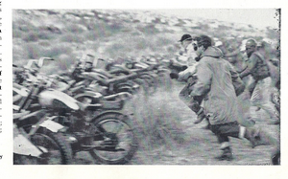
Del Is Home And It Is Time To Ride
Which way did they go!
Out of my way!
To your bikes
Mr. Bad

Slide 24
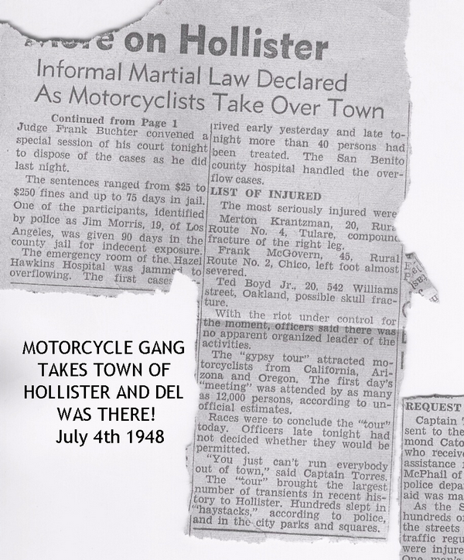
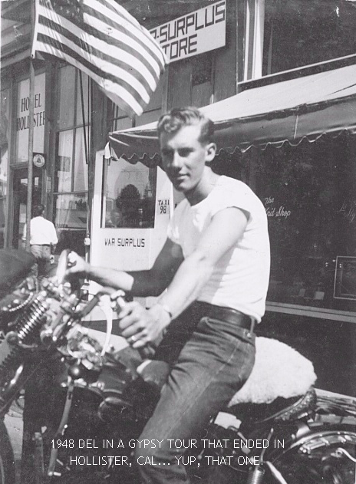
1948 - Del’s Gang Terrorizes A Small Town
My bad!

Slide 25
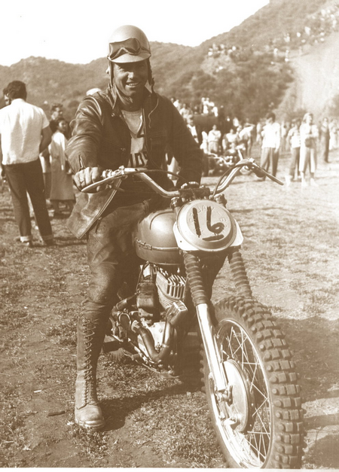
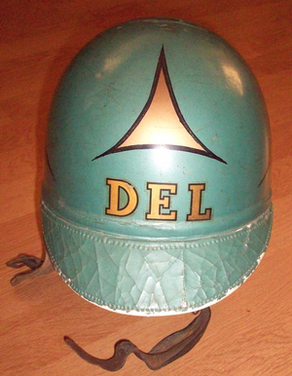
Ride Those Bikes… Safely
Dirt?
What dirt?
Most motorcycle problems are caused by the nut that connects the handlebars to the saddle. ~Author Unknown

Slide 26
Del Slows Down To Get Married
Chains do not hold a marriage together. It is threads, hundreds of tiny threads which sew people together through the years. ~Simone Signoret
Del & Toni get married

Slide 27
Then He Speeds Up Again!
I love snow!

Slide 28
Del Earned “A Few First Place” Awards

Slide 29
Del Wondered, How Can I Go Fast Legally?
Slow down Del!
Del, report at once!
Del gets an idea!
Faster faster!

Slide 30
Del Joined The CHP!
Ready willing and able!
Sign right here young man
Officer Del ready to go!
Cadet Del reporting for duty

Slide 31
1954 - Del Becomes A Daddy
Kurt 1954
Kurt 1959
Del coaches baseball

Slide 32
Now He Can Go Fast
Movie Star? Me? Sure!!
Calling all handsome devils

Slide 33
Del Goes To Hollywood!

Slide 34
Del The Movie Star
The name is Friday…. No no… Tuesday… Ah, yes!… Thursday! That’s it, My name is Thursday!

Slide 35
Devil Take Us Credits
A celebrity is one who is known to many persons he is glad he doesn't know.

Slide 36
1955-Mitzi Gaynor Loved The Movie
Ou La La
He is such a handsome devil!
January 22, 1955 – The Pentagon announces a plan to develop ICBMs
(intercontinental ballistic missiles) armed with nuclear weapons.

Slide 37
Tragedy Strikes As Toni Passes On
A human life is a story told by God. ~Hans Christian Andersen
Kurt and Del

Slide 38
Kurt Grows Up
How about parakeet!
What’s for dinner?

Slide 39
Del’s Parents 50th Anniversary Celebrated With Their Kids
Families are like fudge - mostly sweet with a few nuts. ~Author Unknown

Slide 40
Vicky’s Siblings Meet The Sargeant
Vicky, he is a policeman!
Our gang!
The family is one of nature's masterpieces. ~George Santayana, The Life of Reason
1978 Del retires

Slide 41
1978 - Del Finds Vicky; Vicky Finds Del
She’s jail bait but she’s mine!!
We are family!
Del’s family expands dramatically
October 14 – United States President Jimmy Carter signs a bill into law which allows homebrewing of beer in the United States.

Slide 42
1978 - New Hobby… Flying!
It’s OK, I have 35 minutes experience so far!
You haven't seen a tree until you've seen its shadow from the sky. ~Amelia Earhart
February 11, 1978 – The People's Republic of China lifts a ban on works by Aristotle, William Shakespeare and Charles Dickens.

Slide 43
Del The Pilot
Get this thing down NOW!
Good Landing: Any one you can walk away from!

Slide 44
Retirement Means Hunting & Fishing!
I think animal testing is a terrible idea; they get all nervous and give the wrong answers. ~Author Unknown
I am freezing out here!
The duck gets even!

Slide 45
55 And Starting A New Family…
Hey Da-Da!
I love you!
This wasn’t part of my retirement plan!!
Babies are such a nice way to start people. ~Don Herrold

Slide 46
A son…THEN a daughter…does it end?
Can I have a sister?
I was just kidding guys!
A baby is a blank check made payable to the human race. ~Barbara Christine Seifert

Slide 47
Thank Heaven For Little Girls
A woman can say more in a sigh than a man can say in a sermon. ~Arnold Haultain

Slide 48
First They Break My Wallet Then They Break My Back
Slow down there speedy!
Go faster daddy!
A father carries pictures where his money used to be. ~Author Unknown

Slide 49
Pugs & Hugs & Growing Up
There is no psychiatrist in the world like a puppy licking your face. ~Ben Williams

Slide 50
Next Thing I Knew They Were Grown!
She is so grown up!
He is so grown up!

Slide 51
It Was Happening To Kurt Also…
My little granddaughter, Amanda
She grew up too!
The reason grandchildren and grandparents get along so well is that they have a common enemy. ~Sam Levenson

Slide 52
Amanda Made Me a Great Grandpa Twice
I have a Great Grandpa!
Grace and Zander
Age is an issue of mind over matter. If you don't mind, it doesn't matter. ~Mark Twain

Slide 53
The Families Are Grown So Now What Does He Do???
Golf
Woodys
Dancing
Raises Ruby
Walking Down Aisle
Travel
Hall Of Fame
Trains

Slide 54
2003 – a New Inductee
I’m so old I am in a museum
Del inducted into the Motorcycle Hall Of Fame!
Keep your bike in good repair: motorcycle boots are not comfortable for walking. ~Author Unknown

Slide 55
When Del Speaks, Everybody Listens
Come on Dell, let’s ride!
Garsh!
What do you call a cyclist who doesn't wear a helmet? An organ donor. ~David Perry

Slide 56
Life Moves Forward
I don't care how poor a man is; if he has family, he's rich.

Slide 57
Amber Graduates And Gets Married
Remember I was a CHP Officer
Yes Sir!
The worried look!
There is a good reason they call these ceremonies "commencement exercises." Graduation is not the end; it's the beginning

Slide 58
Father Of The Bride
Who’s the hotty in pink???
Newlyweds become oldyweds, and oldyweds are the reasons that families work. ~Author Unknown

Slide 59
Here He Comes

Slide 60
A New Family Begins
Thank you dad, I love you!
Time for the Happy Dance!
Success in marriage does not come merely through finding the right mate, but through being the right mate. ~Barnett R. Brickner

Slide 61
Del Takes Up Dancing
Who starched my underwear?
I thought he was a gringo!
Hey! Watch the elbows!
He can count to three
Del’s other homie!
Dancing with the feet is one thing, but dancing with the heart is another. ~Author Unknown
Worlds Oldest White Cholo Dancer

Slide 62
Del Tries Golf With His Expert Insructor….
Del was my first challenge

Slide 63
Del Does It Again
Si Senior!
Hurry and say ‘yes’..my knees hurt!
He better say “I Do”!
A man in love is incomplete until he is married. Then he's finished. ~Zsa Zsa Gabor

Slide 64
Our Kids Where There This Time!
Grow old with me! The best is yet to be. ~Robert Browning

Slide 65
Some People Had Other Thoughts
Dad, are you sure you want to do this again???
… and I said Yes again???
Never go to bed mad. Stay up and fight. ~Phyllis Diller

Slide 66
It’s Over… He Did It Again!
Yup! And I would do it again and again!
He is a hunk!
Dad, I warned
Love is an exploding cigar we willingly smoke. ~Lynda Barry
Another happy couple

Slide 67
Del the Romantic
When love is not madness, it is not love. ~Pedro Calderon de la Barca
They are at it again!
A hundred hearts would be too few To carry all my love for you. ~Author Unknow

Slide 68
The Kids Have Left And Del Now Has Ruby All To Himself…. Oh, Vicky Also!
It time for a walk daddy!
Ruby Dooby Doo

Slide 69
Vacations & Dancing
Its only 7-Up
Surprise 33rd with Champagne
Vacation in New England

Slide 70
Del Is Busy These Days With Vicky’s Help
Del is wearing his Hwy 99 shirt upside down again
Life is good!
Time to visit his sister
Time to read Max’s book

Slide 71
Del Still Likes To Go Fast
Faster faster!
Zoooom
This is a simulator?
I saw him in the simulator!
116 miles per hour in reverse
We need a V-12 James!

Slide 72
Del Enjoying Friends
Meet the ice cream gang!
Crazy Paul & Lovely Sue
No, it does not get termites
Adventures with friends
Drive the woody

Slide 73
Enjoying Family Activities
Pssst… Who is the tall guy ??
Don’t know but he has nice legs
Do I have to wear pink???

Slide 74
Del And His Dancing Friends
You can’t hide from us!
A real friend is one who walks in when the rest of the world walks out.
They will never recognize me
Slurp!
Leon shows Del how to disappear
I’m not in here!
Bob demonstrates how to drink wine properly

Slide 75
Laugh A Little; Keeps You Young!
Ah! We now have our Halloween costumes
Paul, Del and Bob
I told him to brush his teeth!
Comparing lengths
Boys will be boys!
Friendship isn't a big thing - it's a million little things. ~Author Unknown

Slide 76
Del Takes Dance Lessons
To watch us dance is to hear our hearts speak. ~Hopi Indian Saying
Yes Mam… No Mam

Slide 77
Dancing With Friends
Mr. Line Dance
Let go like Nancy & Vince
Cardio workout with Donna

Slide 78
Time For An Old Fashioned Dance
Dancing was not invented when I was born!
Del, you cannot dance in motorcycle boots

Slide 79
Enjoy The Elks
Put you little foot in Put your little foot out
Irene and Del practice
the polka

Slide 80
Always A Good Sport
Just don’t tell!
Don’t ask… Don’t tell!

Slide 81
Sometimes It’s Hard To Explain!
I didn’t mean to!
My new theme coordinated tie

Slide 82
Del Enjoys The Holidays
People will talk…
Now what would you like for Christmas
Always a romantic!
I told him I was NOT Santa! He insisted!

Slide 83
Del’s Beautiful Bride Keeps Him Young
Love is a symbol of eternity. It wipes out all sense of time, destroying all memory of a beginning and all fear of an end . ~Author Unknown
Love is the condition in which the happiness of another person is essential to your own. ~Robert Heinlein

Slide 84
Looking Back; Life Was Good!
And Getting Better
Life is simple, it's just not easy. ~Author Unknown
I never really liked donuts
I didn’t end up like this!
My life has a superb cast but I can't figure out the plot. ~Ashleigh Brilliant

Slide 85
90 Here I Come!
I love parties!
I created a party animal!

Slide 86
Not Quite . . .
May I see your drivers license please?
Careful or Del will give YOU a ticket!

